Slide 1
Weibull distribution

Slide 2
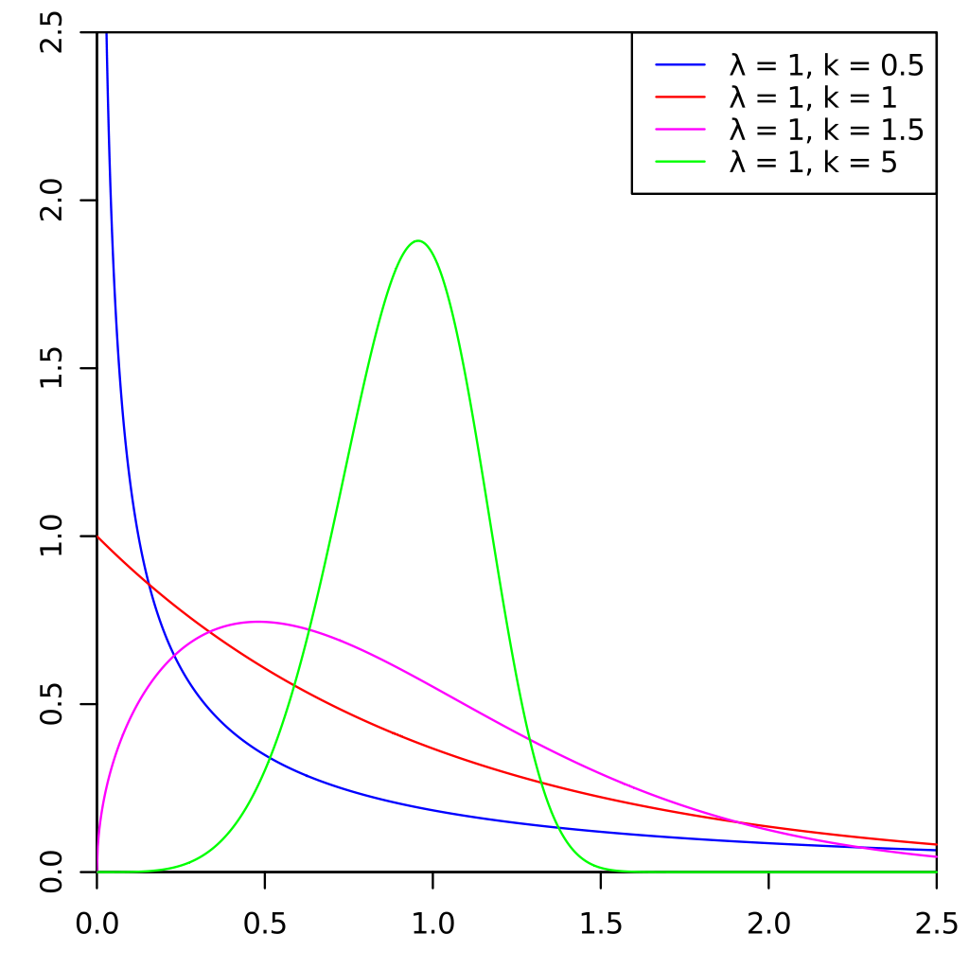
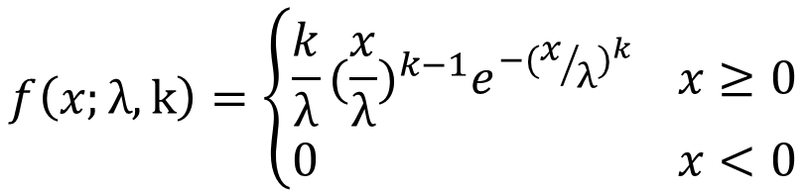
$$f\left(x;λ,k\right)=\left\{\begin{aligned}\frac{k}{λ}{(\frac{x}{λ})}^{k−1}e^{−{(x/λ)}^{k}} x≥0 \\ 0 x<0\end{aligned}\right.$$
λ : scale parameter
k : shape parameter

Slide 3
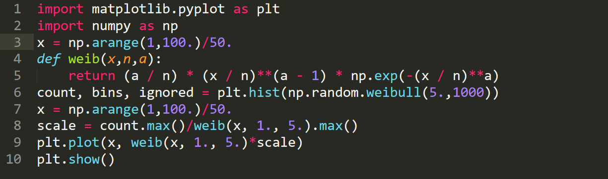
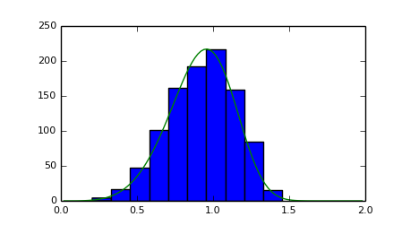
python

Slide 4
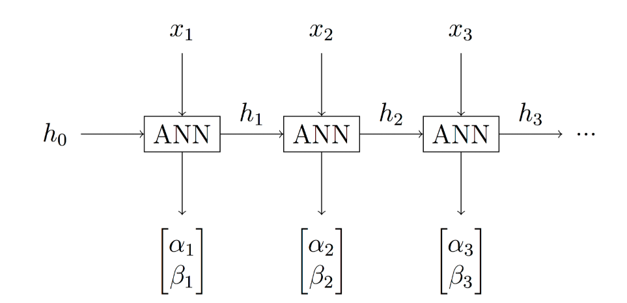

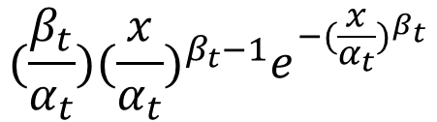
WTTE-RNN
$$(\frac{β_{t}}{α_{t}}){(\frac{x}{α_{t}})}^{β_{t}−1}e^{−{(\frac{x}{α_{t}})}^{β_{t}}}$$

Slide 5
Beware of Weibull euphoria
The Weibull distribution has a:
Continuous and discrete variant
Expressive. Can take many shapes by adjusting its two parameters.
Closed form PDF, CDF, PMF, expected value, Median, Mode, Quantile function (inverse CDF)
Used everywhere for predicting things that will brake since it magically appears in nature just like the normal distribution
Weakest link property : If a system breaks with the failure of any of its independent identical components then the time to failure is approximately Weibull distributed.
Built in regularization mechanisms. By controlling the size of ββ we control the peakedness hence the confidence of predicted location.

Slide 6
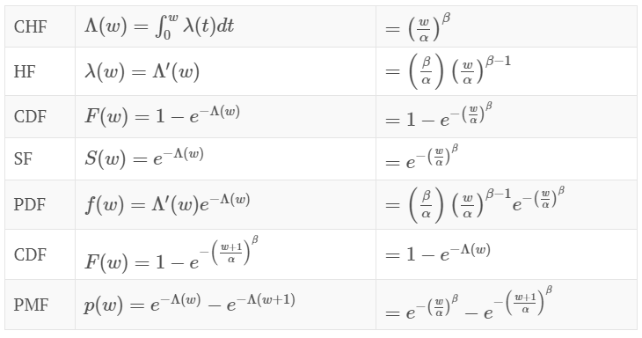

Slide 7



HF & CDF
HF: Calculating the failure rate for ever smaller intervals of time
CHF: HF must not decrease too quickly, since, by definition, the cumulative hazard has to diverge.

Slide 8



CDF & PDF
CDF:
$$=π$$
PDF:
S(t)

Slide 9
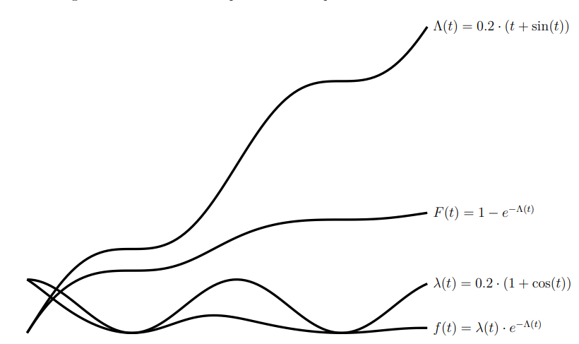
Example for 4 function

Slide 10



Loss function (log-likelihood)
Likelihood function:
We want to maximize likelihood.
Loss function (log-likelihood):
$$θ=\left({α \atop β}\right)$$

